Slide 1


Review II Presentation on
TERNA ENGINEERING COLLEGE, NAVI MUMBAI
DEPARTMENT OF COMPUTER ENGINEERING
PLANNER – “Ensuring a better scheduling”
1. ONKAR SHINDE TU3F2324078 B20
2. YUVANSH KOLI TU3F2324068 B11
3. ARYA MAHNAGADE TU3F2324074 B17
Under the guidance of
- Prof. D. K. Chitre
CS-B-SEM III
Academic Year 2023-24

Slide 2
Index
1.Abstract
2. Introduction
3. Literature Survey
4. Problem Statement
5. Objectives
6. Scope
7. Proposed Methodology
8.System Architecture
9.Tools And Database Required
10.Implementation Snapshots
11.Conclusion
12.References

Slide 3
Abstract
This project develops a Time Management and Task Allotment app designed to enhance productivity and streamline personal and professional scheduling.The app provides a comprehensive platform for users to organize their tasks, set priorities, and manage their time effectively.Key features include customizable task lists, automated reminders, and integration with calendar systems to synchronize deadlines and appointments. By leveraging advanced algorithms for task prioritization and time allocation, the app aims to optimize daily routines and improve overall efficiency.The project addresses common time management challenges, offering intuitive tools for users to balance workloads and achieve their goals with greater ease.

Slide 4
Introduction
In an era of constant demands and distractions, effective time management and task allocation are essential for productivity. Our project addresses this need by developing a Time Management and Task Allotment app designed to streamline daily scheduling and enhance efficiency. The app features customizable task lists, automatic reminders, and calendar integration to help users organize their activities and prioritize effectively. By leveraging advanced algorithms, it aims to simplify task management and improve overall productivity, empowering users to achieve their goals with ease.

Slide 5
Literature Survey
Sr.No | Title | Authors | Journal | Year | Summary | Link
01 | Systematic literature review of integrated project scheduling and material ordering problem | Parchami Afra Ali, Kheirkhah Amirsaman, Ahadi Hamidreza | Computers & Industrial Engineering | 2022 | This paper reviews integrated project scheduling and material ordering problems, discussing formulations and solution methods. It highlights the importance of considering both scheduling and procurement in project management. | Link
02 | Smart manufacturing scheduling: A literature review | Serrano-Ruiz Julio C., Mula Josefa, Poler Raúl | Journal of Manufacturing Systems | 2021 | The paper reviews existing literature on smart manufacturing scheduling, focusing on digital twin technology and zero-defect manufacturing models. It identifies trends and gaps in current research related to scheduling in smart factories. | Link
03 | Project planning and scheduling: A literature review | Dariusz Wolejszo | LinkedIn | 2021 | This review discusses various methods and tools for project planning and scheduling, emphasizing the distinction between planning and scheduling as separate tasks crucial for project success. | Link
04 | Literature review: Project schedule planning tools and techniques | Liberatore et al. | Jurnal Teknologi | 1989 | This paper presents various project schedule planning tools, including Gantt charts and critical path methods, while addressing the gap between theory and practical application in project management software. | Link

Slide 6
Literature Survey
Sr.No | Title | Authors | Journal | Year | Summary | Link
05 | Scheduling research contributions to Smart manufacturing | Various Authors | Journal of Manufacturing Processes | 2017 | The paper reviews contributions to scheduling research within smart manufacturing contexts, focusing on challenges posed by Industry 4.0 technologies and proposing future research directions in this area. | Link
06 | A survey of hybrid metaheuristics for the resource-constrained project scheduling problem | Various Authors | European Journal of Operational Research | 2019 | This survey discusses hybrid metaheuristic approaches for solving resource-constrained project scheduling problems, providing insights into algorithm performance and applicability in real-world scenarios. | Link
07 | Integrated planning of project scheduling and material procurement | Various Authors | Computers & Industrial Engineering | 2018 | This study integrates project scheduling with material procurement processes, emphasizing the need for coordinated planning to enhance efficiency and reduce costs in construction projects under uncertainty conditions. | Link

Slide 7
Problem statement
Many individuals and teams struggle to manage time and tasks effectively due to the lack of a centralized, user-friendly platform that integrates scheduling, task prioritization, and real-time collaboration, leading to missed deadlines and reduced productivity.

Slide 8
Objectives
Productivity Enhancement: Improve productivity by minimizing missed deadlines and reducing task-related stress.
Integration with Existing Tools: Allow integration with popular tools (e.g., Google Calendar, Slack, Microsoft Teams) for a seamless workflow.

Slide 9
Scope
Task List – Users can create a customizable task list based on priority.
Schedule Meeting – Includes a meeting planner feature.
Notes – Allows users to make daily notes.
Plan My Day – A day planner for organizing daily activities.
Calendar Integration – For yearly planning and scheduling.
Notifications – Provides task reminders.
Profile – Account and profile management section.

Slide 10
Future Scope
Progress Tracking with Statistics: Provide users with the ability to track their progress through graphical summaries (e.g., charts and graphs).
Reward System:Introduce a reward system where users earn rewards (such as Amazon gift vouchers) for completing tasks efficiently.
Platform Scalability:Expand the platform beyond individual users to support corporate networks, and enable functionalities for student-teacher interaction, such as notes sharing and assignment submissions.

Slide 11
Hardware And Software Used
Frontend Development:
Languages: HTML, CSS, JavaScript.
Frameworks/Libraries: React JS.
2. Backend Development:
Languages: JavaScript (Node.js), Java etc.
Frameworks: Express (Node.js).
Databases: MySQL.
3. Development Machines:
Desktops/Laptops: for coding, testing, and debugging.
Testing Devices: Multiple devices (smartphones, tablets,laptops) to test responsiveness and functionality.

Slide 12
Proposed system
Literature Review
Analyze existing research on time management and scheduling practices.
Needs Assessment
Collect data through surveys and interviews to identify user challenges.
Framework Development
Create a structured scheduling framework based on insights from research and user needs.
Technology Integration
Evaluate and recommend digital tools to enhance scheduling effectiveness.
Implementation Guidelines
Provide practical steps, templates, and resources for users.
Pilot Testing
Test the framework with a select group and gather feedback.
Feedback and Refinement
Adjust the framework based on user input to improve usability.
Finalization and Dissemination
Finalize the planner and develop a plan to share it with the target audience.
Expected Impact
Create a practical scheduling framework that enhances productivity and empowers users to manage their time effectively

Slide 13
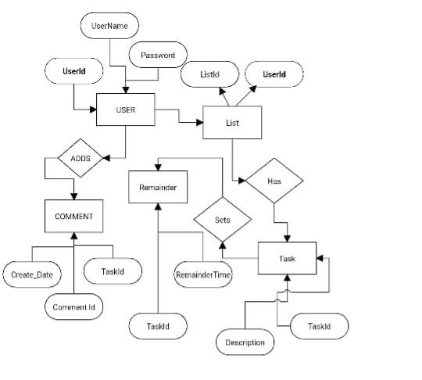
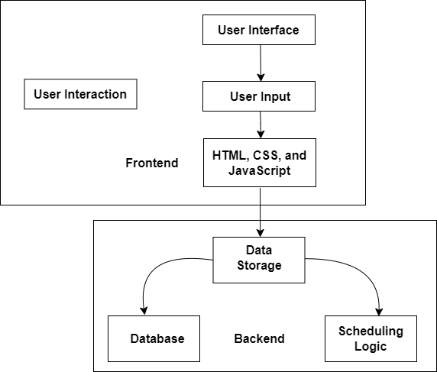
Proposed system

Slide 14
Implementation
User Authentication:
Display login/register page.
Authenticate user credentials.
Redirect to dashboard upon successful login.
Dashboard Display:
Show tasks list (pending and completed).
Display options for adding, editing, or deleting tasks.
Fetch user tasks from the database. Sidebar Navigation.
Add Task:
Click "Add Task" button.Input task details (title, description, priority, deadline).
Save task to the database.
Edit Task:
Select task from the list.
Modify task details (title, description, etc.).
Update task in the database.

Slide 15
Implementation
Delete Task:
Select task to delete.
Remove the task from the database.
Task Completion:
Mark task as completed.
Update task status in the database.
View Completed Tasks:
Option to view all completed tasks.
Fetch and display from the database.
Logout:
End user session and redirect to the login page.

Slide 16
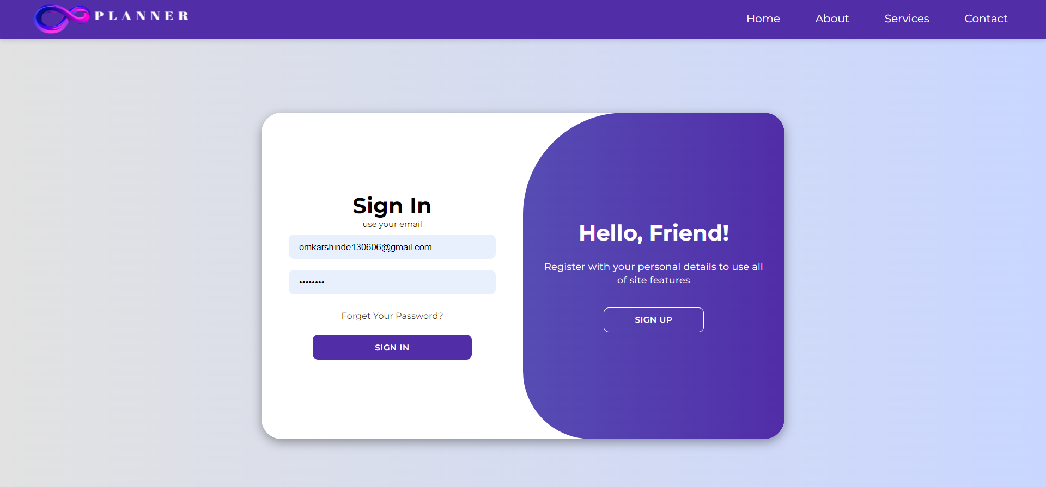
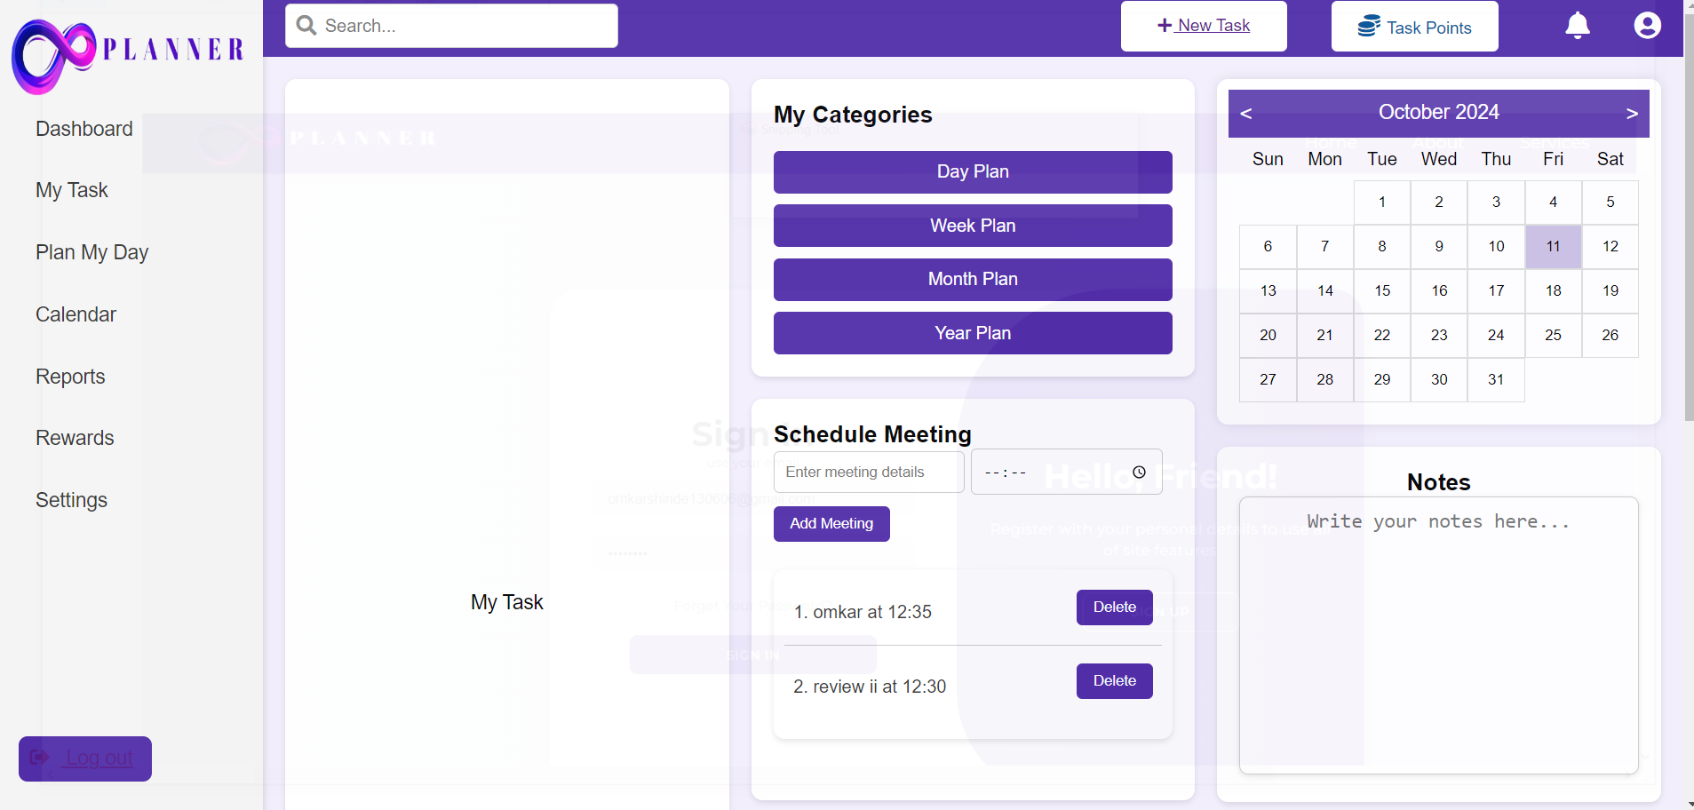
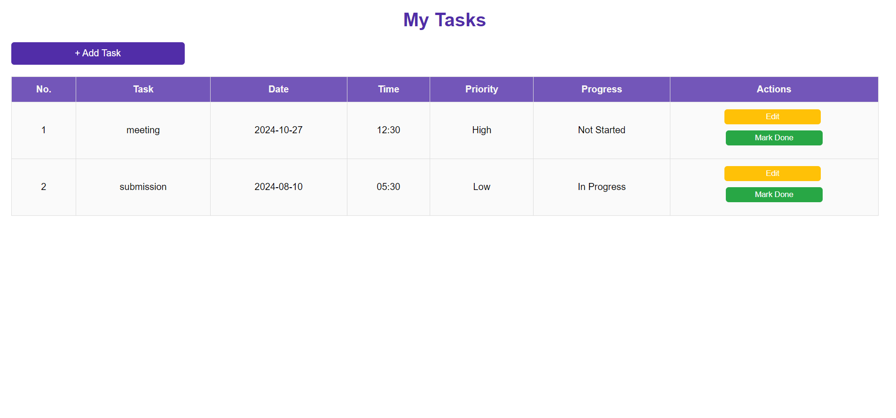
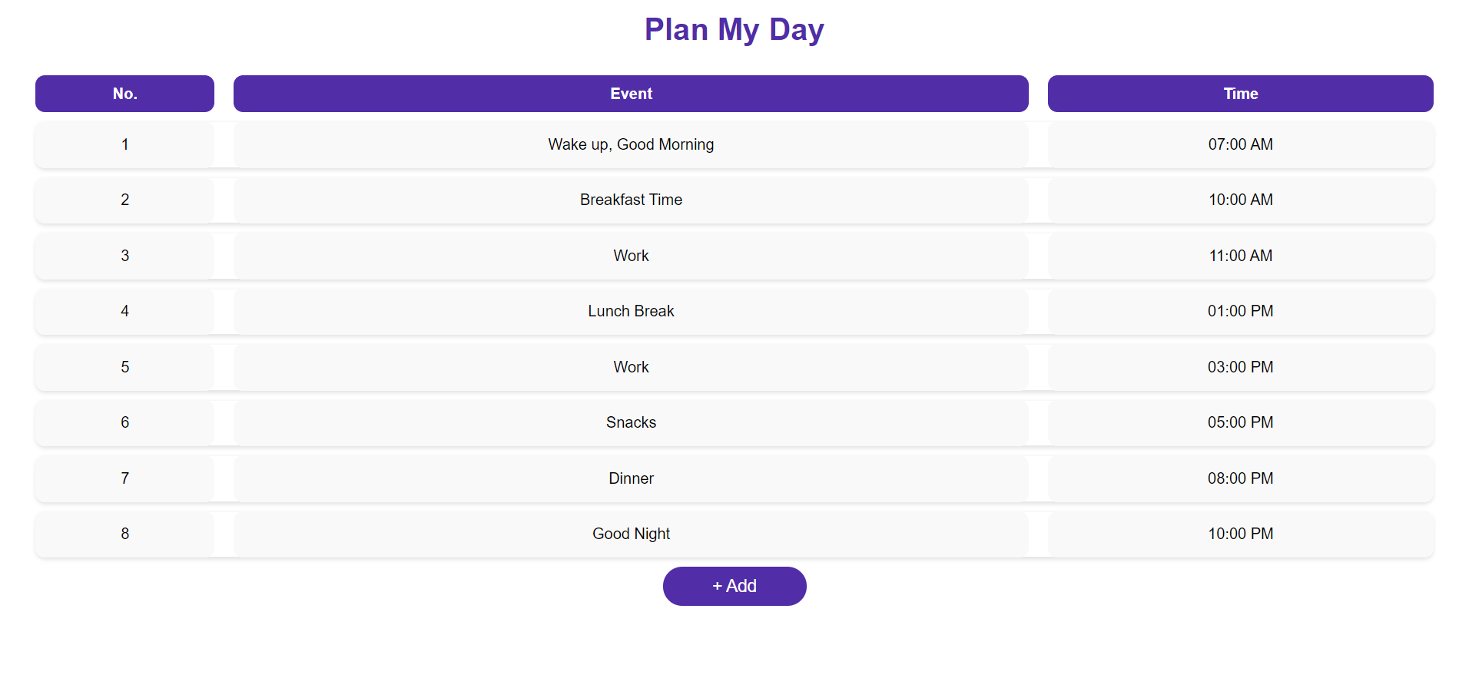
Results

Slide 17
Conclusion
In conclusion, the Planner website offers an efficient and user-friendly platform for managing daily tasks, organizing schedules, and tracking progress. By providing features such as task creation, editing, deletion, and completion tracking, it simplifies the user's workflow and helps improve productivity. The integration of a clean dashboard, along with a functional sidebar containing options like calendar, notes, and meeting schedules, makes it a comprehensive tool for both personal and professional use. The website's intuitive design ensures ease of use, making task management a seamless process for users.

Slide 18
References
1.Implementing an Academic Task Manager: Findings from a Pilot Study, Indian Journal of Science and Technology, Vol 12(4), DOI: 10.17485/ijst/2019/v12i4/141142, January 2019,Author senanu.
https://www.researchgate.net/publication/331204656_Implementing_an_Academic_Task_Manager_Findings_from_a_Pilot_Study
2.Akmal Rosli, M. D. ., & Saad, S. Z. . (2023). E-Planner Scheduling System (EPSS): Jotting Down and Managing Schedule Online. Multidisciplinary Applied Research and Innovation, 4(1), 179-183.
https://publisher.uthm.edu.my/periodicals/index.php/mari/article/view/9889
3.Lawrence Livermore National Lab. (LLNL), Livermore, CA (United States), AC52-07NA27344, LLNL-TR-830439; 1046694.
https://www.osti.gov/servlets/purl/1837813
4.Title: All in One Manager Application for Android Operating System, Authors: Kapoor, Karan Bhatt, Ravindara [Guided by], Keywords: Android operating system Android architecture,Issue Date: 2015, Publisher: Jaypee University of Information Technology, Solan, H.P.
http://www.ir.juit.ac.in:8080/jspui/handle/123456789/5823
5.Project Report of Calendar App with Task Planner,May 2023,Conference: CSE 100 - Software Development 1 Course Project,At: Dhaka, Bangladesh, Authors:Asifur Rhaman.
(PDF) Project Report of Calendar App with Task Planner (researchgate.net)

Slide 19


